Slide 1
Grower Toolkit
Sample slides to include in retail/foodservice sales presentations

Slide 2
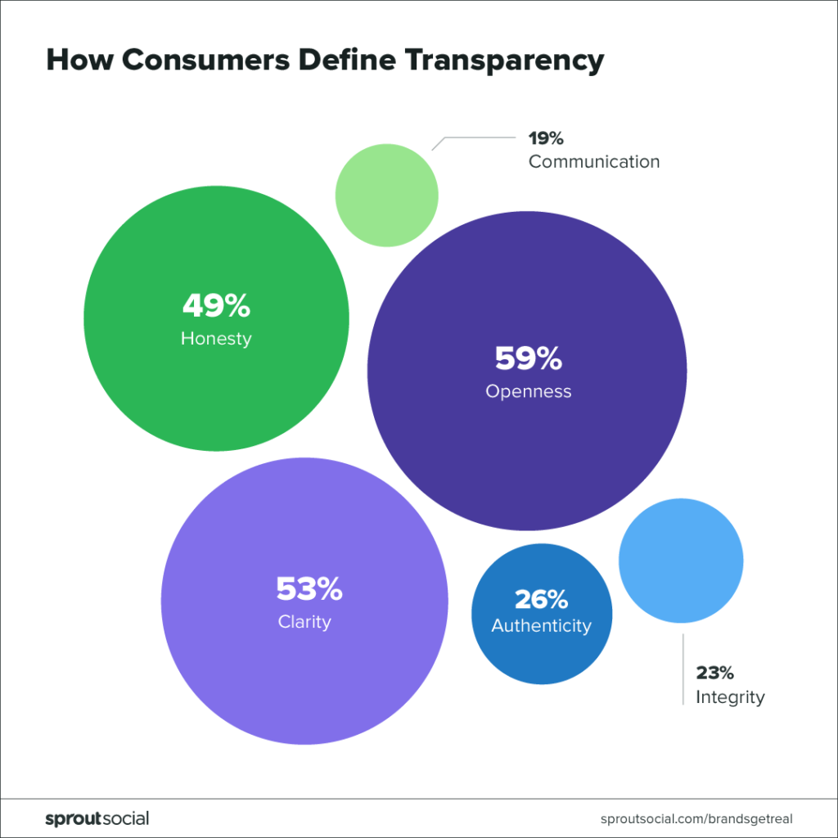
Why Transparency Matters
86%
of Americans believe transparency from businesses is more important than ever before
Willing to pay more for products that guarantee transparency
73%
85%
Are more likely to stick by a business during a brand crisis if it has a history of being transparent
Source: From Risk to Responsibility: Social Media and the Evolution of Transparency by Sprout Social

Slide 3
Transparency, Innovation & Progress
Partnership With Equitable Food Initiative (EFI)
Workforce Development Programs
A collaborative team approach creates culture of continuous improvement
Empowers our employees to become a united team, working closely together at all levels of the organization to deliver the best quality produce

Slide 4
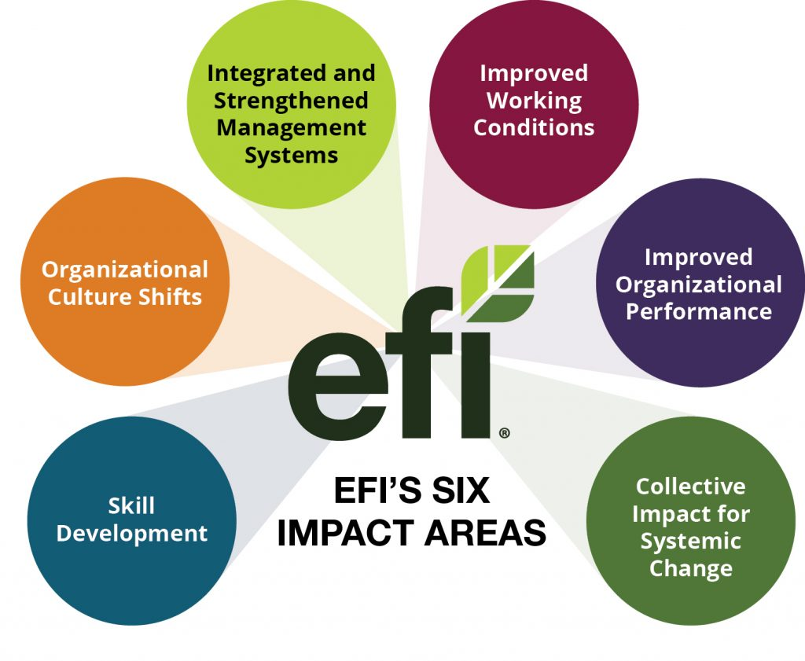
EFI Program Impact Areas
Increases collaboration and transparency for the fresh produce supply chain
Creates positive outcomes for both the individual employees and our organization as a whole
Addresses the requirements of the Ethical Charter on Responsible Labor Practices

Slide 5
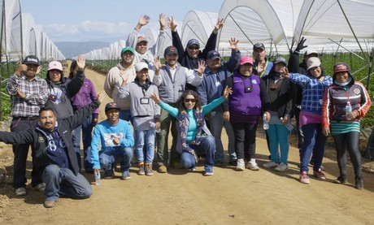
Benefits of Workforce Development
Helps us maximize efficiencies and increase productivity
Workers take more pride in their job
Committed to producing the safest, best-quality product
Strengthens our ability to innovate
In an Acute Labor Shortage
Helps us attract the best talent and retain seasonal workers
We’ve become an employer of choice
By increasing job satisfaction and growth opportunities, we’ve earned the long-term trust and loyalty of our workers
Placement Holder Only

Slide 6
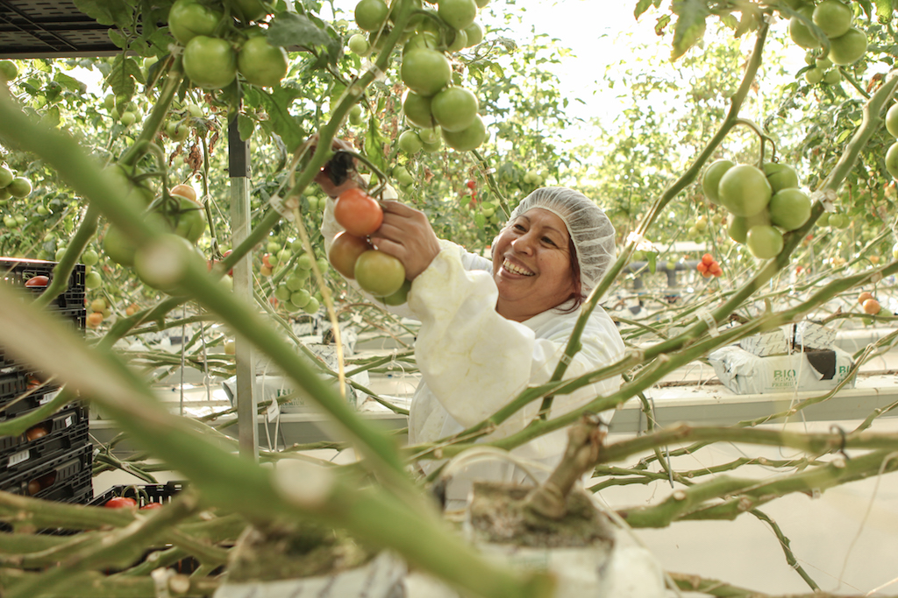
Our Commitment to Food Safety
EFI certification requires more than 300 standards for labor practices, food safety and pest management
Workers are trained to identify, mitigate and respond to issues that compromise food safety
Including illness, presence of pests or animals, hygiene and sanitation
Placement Holder Only

Slide 7
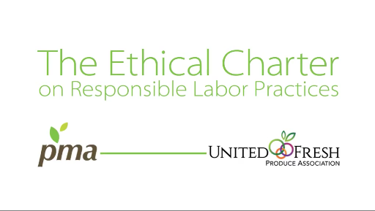
Social Responsibility & The Ethical Charter
We share the vision of the Ethical Charter because it’s the right thing to do
We treat all our employees with the dignity and respect they deserve
EFI certification ensures direct communication with employees and integrated management systems, as detailed in the Ethical Charter

